Slide 1
Challenges in teaching employability capabilities for the web
Add presenters
Conference name, location
Date
1

Slide 2
Learning outcomes
Identify and discuss learning and teaching methods for developing employability capabilities
Identify forces that facilitate employability teaching
Identify barriers to developing employability teaching
Plan to reduce, remove or circumvent a barrier
2

Slide 3
Employability capabilities
Critical thinking
Problem solving
Communication
Adaptability
Flexibility
What else……..
3

Slide 4
Activity 1 – Learning and teaching methods
Identify learning and teaching methods for developing capabilities through tertiary curricula. Consider methods that:
raise students’ awareness of their level of development and the capabilities that are necessary for a successful career (and life)
prepare our students for a future characterised by rapid change and where global and sustainability issues can not be ignored
prepare students for transition out of university and into employment
4
Notes:
Participants to forms small groups of 3 to 5
Their task is to think of learning and teaching methods for developing employability capabilities
Groups to agree 4 to 6 learning and teaching methods for effectively developing employability capabilities within tertiary curricula
For each method give an example (if possible)

Slide 5
Activity 2 – Forces for an against teaching employability
Work in small groups to think of the approaches to answer 2 questions:
What forces help us to teach employability capabilities?
What are the barriers to teaching employability capabilities?
You have about 10 minutes
5
Notes:
Groups present back to larger group

Slide 6
Activity 2 – Forces for an against teaching employability
New learning and teaching methods
Forces for change
Forces against change
What forces and arguments encourage change, push us forwards, make life better and improve our teaching?
What forces and arguments stop us changing or make life difficult?
6
Notes:
In same groups from activity 1, ask groups to detail forces that will support / hinder learning and teaching methods for developing capabilities

Slide 7
Activity 2 – Feedback
What forces support change?
What forces hinder change?
7
Notes:
Groups present back to larger group

Slide 8
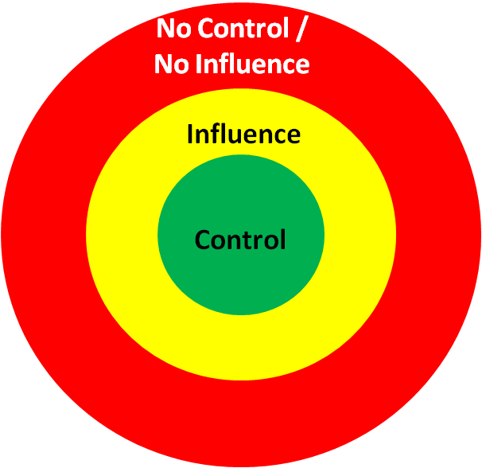
Activity 3 – Reduce, remove or and circumvent a barrier
What could you do to reduce, remove or circumvent one barrier to developing employability capabilities in your teaching?
8

Slide 9
Review
Identify and discuss learning and teaching methods for developing employability capabilities
Identify forces that facilitate employability teaching
Identify barriers to developing employability teaching
Plan to reduce, remove or circumvent a barrier
9
Notes:
Summarise workshop and touch on points that relate to each of the learning outcomes

